Slide 1
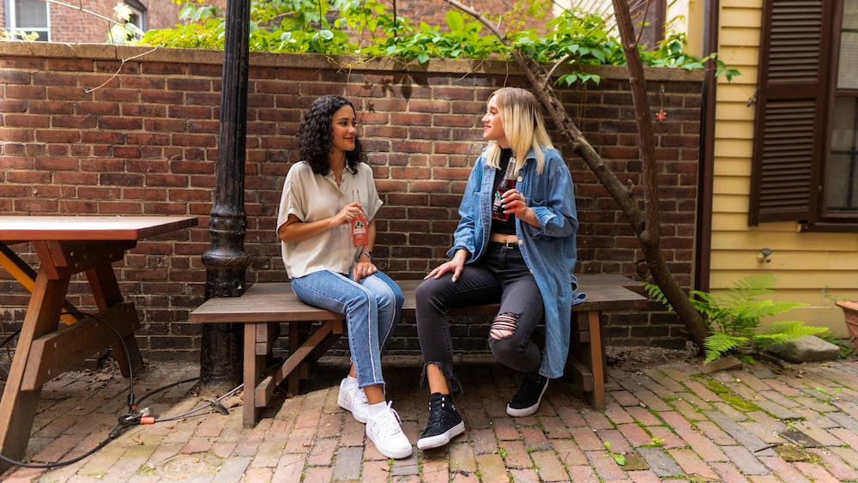
Recommendation for Better Conversational Skills Using Transformer Based Speech-to-text and ChatGPT
Capstone Design2; Team 1

Slide 2
Contents
1. Introduction
2. System Structure
3. Results

Slide 3
Intro: what made us start this project?
We all suffered from isolation because of COVID-19
Some may struggle to have conversations with others after it
Recommendation for better conversational skills is necessary

Slide 4
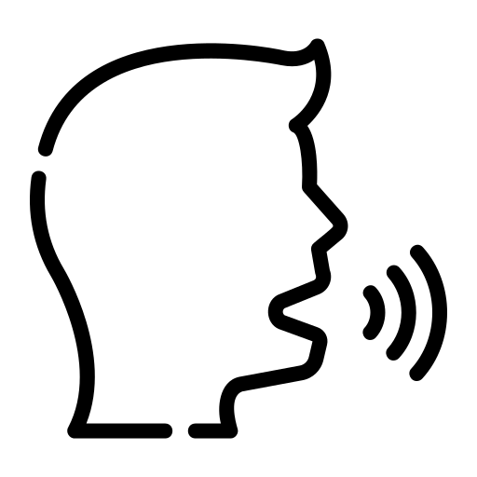




System Structure
Save audio data
Transcribe by speakers
Conversation
Data processing
Transcription is fed into
Whisper Model
Return results
ChatGPT
Show a better conversation

Slide 5
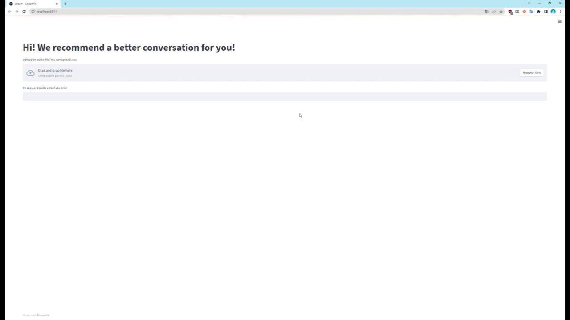
Results

